Slide 2
Data Analysis
IPL Data Set
Srinidhi K

Slide 3
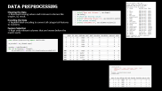

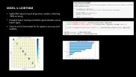




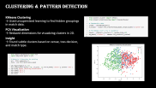
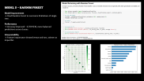

Slide 4
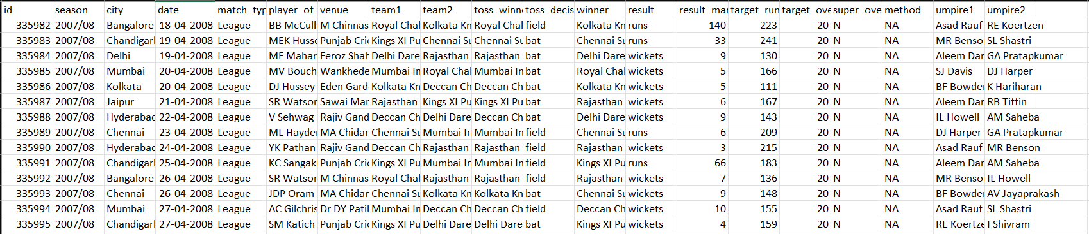
Introduction & Objective
Goal of the Project → To predict the winner of an IPL match using only pre-match details.
Dataset Used → IPL matches from 2008 to 2024 with team, venue, toss, and outcome data.
Why This is Useful → Helps understand game dynamics and improves decision-making in cricket.

Slide 5
Data Understanding & Loading
Dataset Inspection → Loaded matches.csv and examined rows, columns, and data types.
Column Review → Focused on relevant fields like team1, team2, toss_winner, venue, and winner.
Initial Observations → Found that the data contains match-level info; no player-level stats.

Slide 6
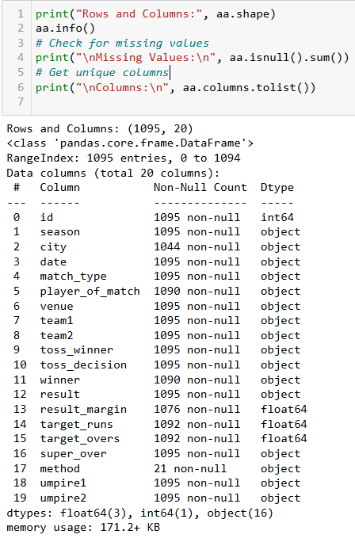
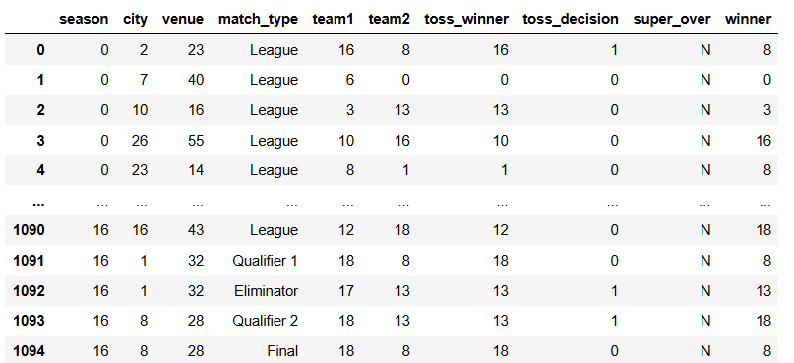
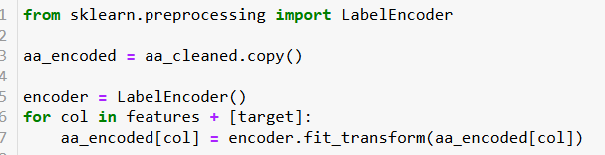
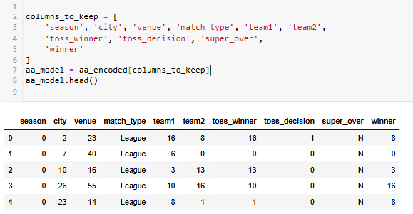
Data Preprocessing
Cleaning the Data → Removed missing values and irrelevant columns like umpire, id, result.
Encoding the Data → Applied label encoding to convert all categorical features to numbers.
Feature Selection → Kept only relevant columns that are known before the match starts.

Slide 7
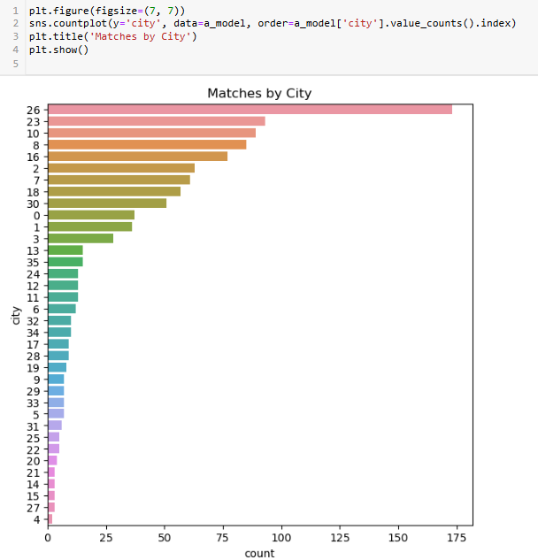
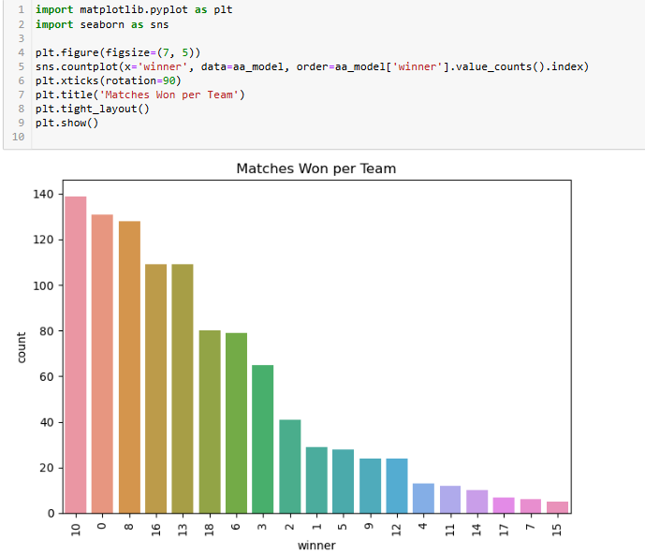
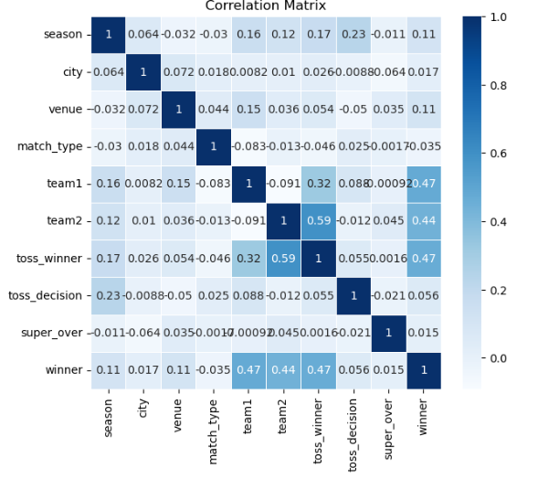
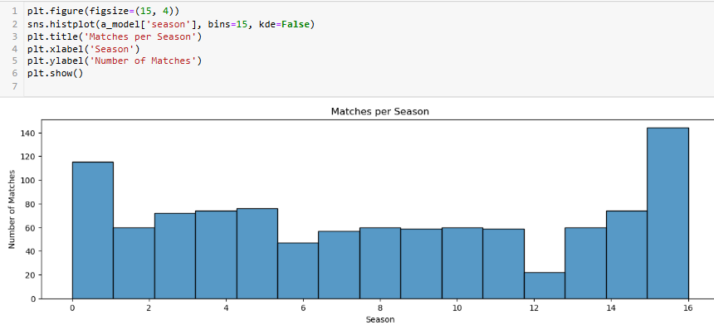

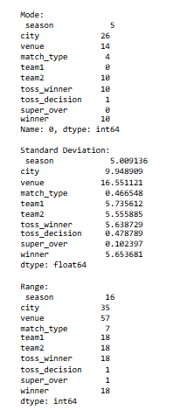
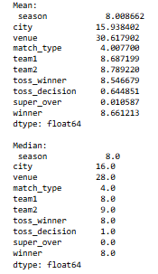
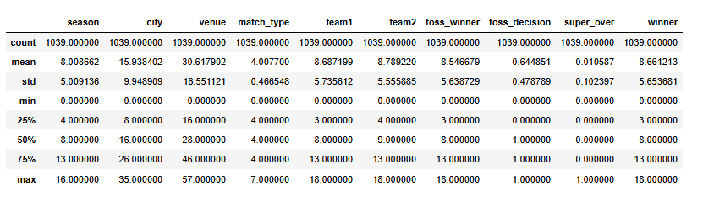
Exploratory Data Analysis (EDA)
Descriptive Statistics → Calculated mean, median, mode, standard deviation, and range.
Categorical Analysis → Summarized win counts per team, toss decisions, and match types.
Visual Insights → Created bar plots and histograms to identify trends and patterns.

Slide 8
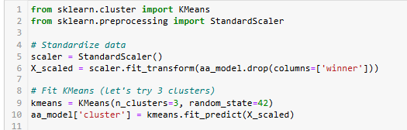
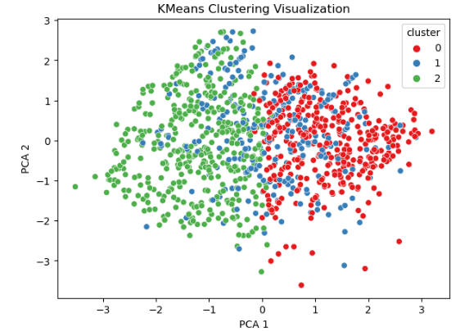
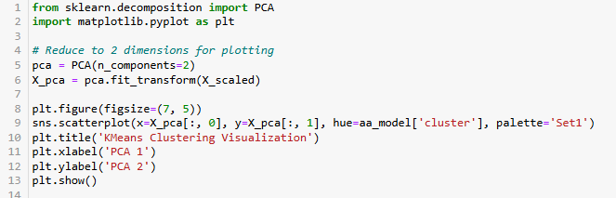
Clustering & Pattern Detection
KMeans Clustering → Used unsupervised learning to find hidden groupings in match data.
PCA Visualization → Reduced dimensions for visualizing clusters in 2D.
Insight → Found subtle clusters based on venue, toss decision, and match type.

Slide 9
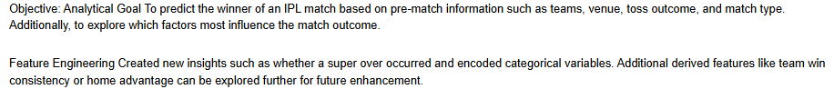
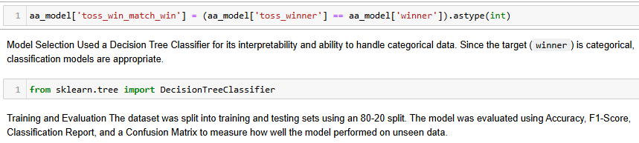
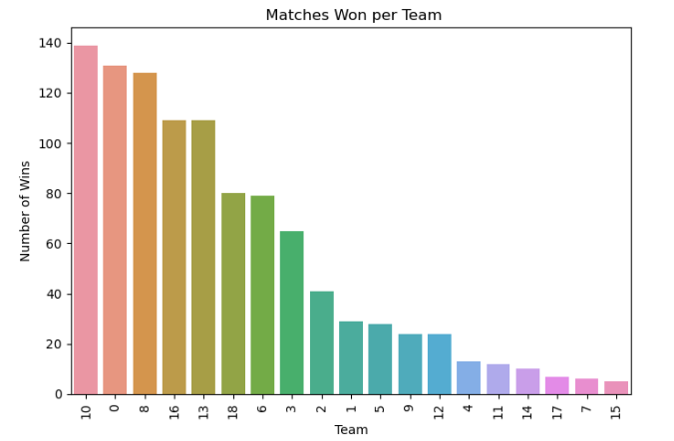
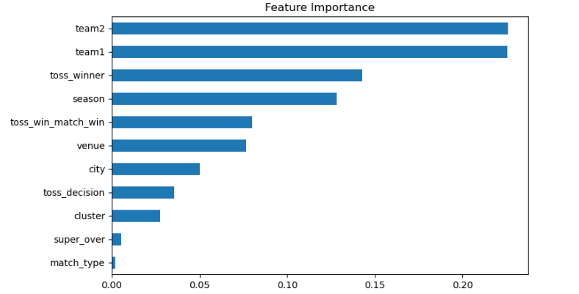
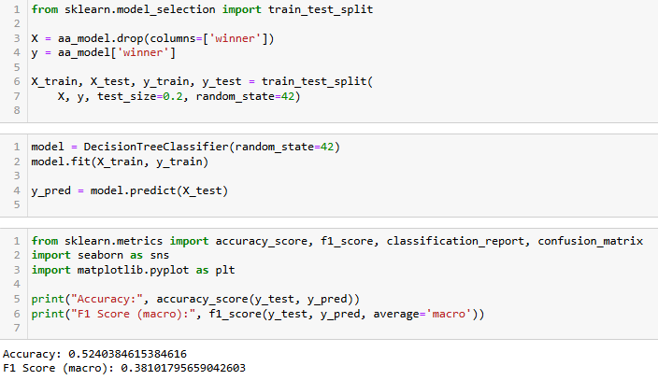
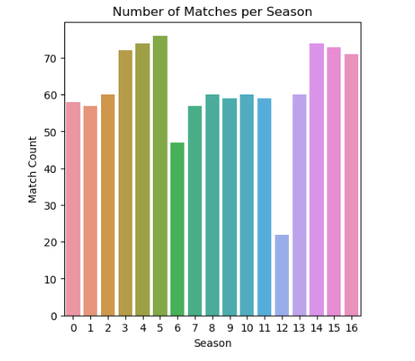
Model 1 – Decision Tree
Model Training → Used Decision Tree Classifier as a simple and interpretable baseline.
Evaluation → Accuracy was moderate – 0.524038; good start but not strong generalization.
Conclusion → Needed more complex models for better accuracy.
Visualization:

Slide 10
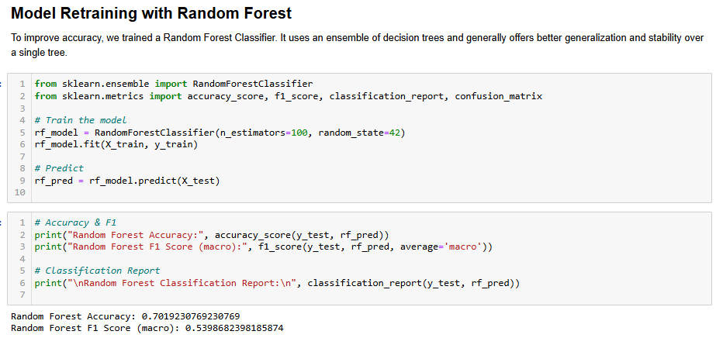
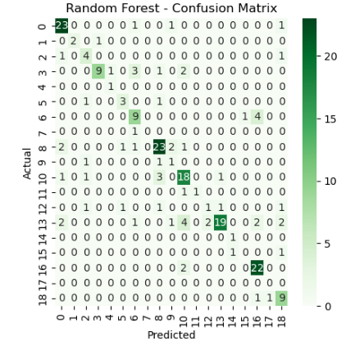
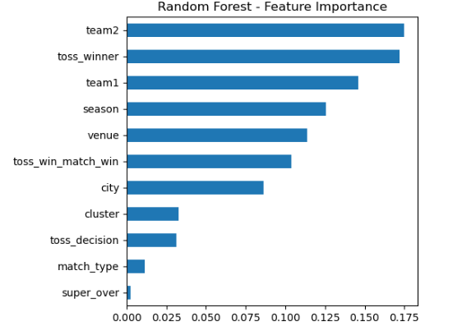
Model 2 – Random Forest
Model Improvement → Used Random Forest to overcome limitations of single tree.
Performance → Accuracy improved – 0.7019230, more balanced predictions across classes.
Interpretability → Feature importance showed venue and toss_winner as impactful.

Slide 11
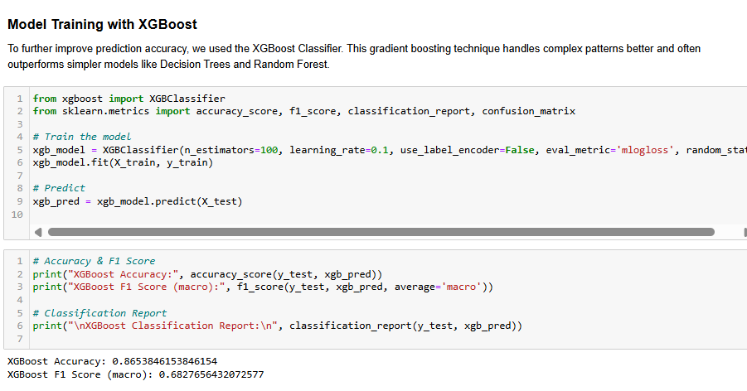
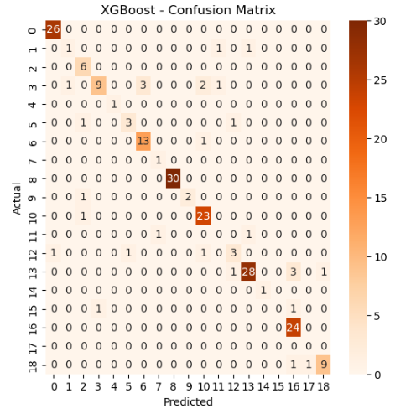
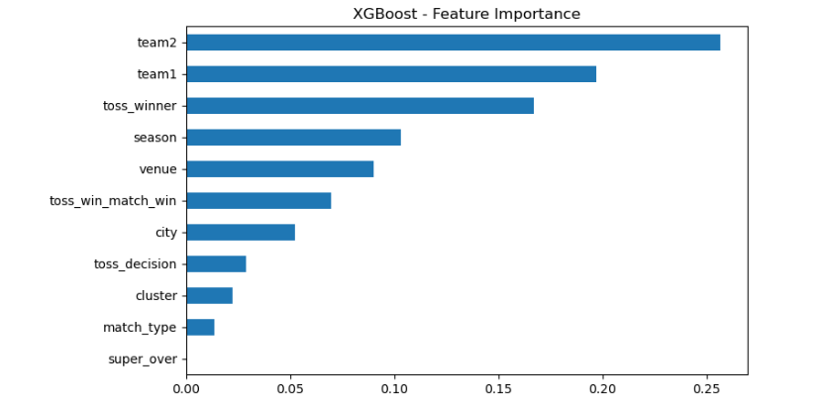
Model 3
Trained XGBoost classifier, achieved ~80% accuracy on test data.
Captured complex non-linear interactions better than previous models.
Though performance was good, this was not finalized as the best model.

Slide 12
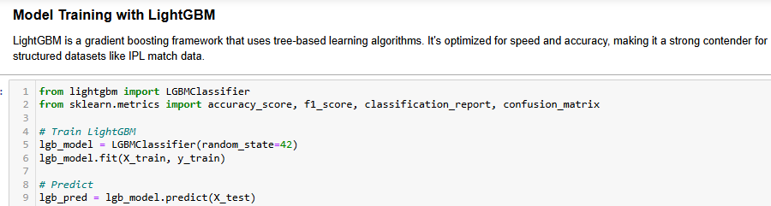
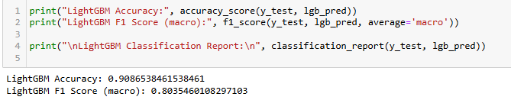
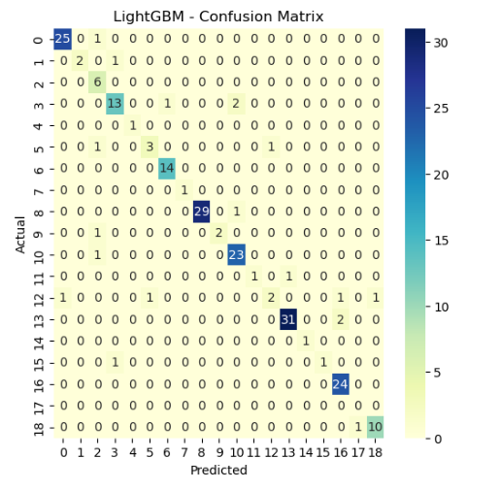
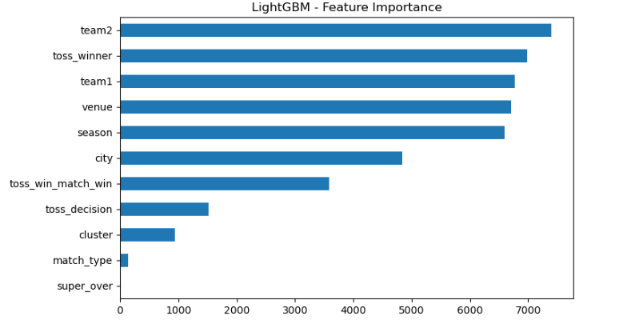
Model 4: LightGBM
LightGBM outperformed all previous models, achieving ~90% accuracy.
Provided faster training and better generalization across match types.
Chosen as the final model for its superior accuracy and stability.

Slide 13
Conclusion & Recommendation
Best Model Selected – LightGBM Classifier Achieved the highest accuracy of 0.90 on test data. Outperformed all other models in predicting match winners with better speed and generalization.
Compared with Decision Tree Decision Tree gave 0.52 accuracy. Simpler but less effective; prone to overfitting and bias toward dominant classes.
Compared with Random Forest Random Forest improved performance to 0.70 accuracy. More stable than Decision Tree, but still not as accurate or fast as LightGBM.
Compared with XGBoost XGBoost reached 0.86 accuracy. Powerful and accurate, but LightGBM was faster and performed better with large categorical data.
Why LightGBM is Better Captures complex relationships using gradient boosting with optimized speed. Handles categorical features efficiently and gives excellent feature importance insights (toss winner, team, venue). Uses leaf-wise tree growth, which improves accuracy on classification problems.
Final Recommendation For match outcome prediction using only pre-match information, LightGBM Classifier is the most reliable.

Slide 14
Entire Project Workflow – Step-by-Step Process
1. Loaded the Dataset
Used matches.csv from IPL (2008–2024).
Checked rows, columns, and data types.
2. Explored the Data
Described the dataset using .info(), .describe().
Found the target variable: winner.
Identified and removed irrelevant columns.
3. Selected Independent Features
Chose 7 features: team1, team2, venue, city, toss_winner, toss_decision, season.
These features were known before a match started.
4. Encoded Categorical Data
Used Label Encoding to convert team names, venues, etc. into numbers.
5. Performed Descriptive Analysis
Calculated mean, median, standard deviation, min, max, and quartiles.
6. Visualized Data (EDA)
Plotted:
• Count plot for team wins
• Histogram for matches per season
• Box plot for match venues
• Correlation heatmap and pairplot
7. Detected Patterns using Clustering
Applied StandardScaler for normalization.
Performed KMeans clustering and visualized using PCA.
8. Model 1 – Decision Tree Classifier
Split data into train/test.
Trained and evaluated the model.
Accuracy = 0.52
Simpler but prone to overfitting.
Visualized confusion matrix and feature importance.
9. Model 2 – Random Forest
Retrained model with better generalization.
Accuracy = 0.70
More stable but not as accurate as boosting models.
Visualized confusion matrix and top features.
10. Model 3 – XGBoost Classifier
Trained and tested using XGBoost.
Accuracy = 0.86
Captured complex relationships using gradient boosting.
Visualized feature importance and model predictions.
11. Model 4 – LightGBM Classifier (Best Model)
Final model trained and tested using LightGBM.
Achieved the highest accuracy = 0.90
Faster and more efficient than XGBoost with better handling of categorical data.
Confirmed using confusion matrix and feature insights.
12. Final Result
Project covered full ML pipeline: Loading → Preprocessing → EDA → Modeling → Evaluation.
LightGBM selected for its superior performance, accuracy, and reliability.
Can be extended using player-level or ball-by-ball data for further improvement..

